Slide 1
Staff Management - 2
Technical Design

Slide 2
Objective
Tracking Customer Sales users referrals were added in the previous phase. We want to track Agent referral in the current release.

Slide 3
New Features
Linking agent customer accounts with Agent Relationship Representative[ARR] & Agent Relationship Manager [ARM]
Restricting Customer Type of linked customers according to user job title
Changing Staff to User in Koko Admin

Slide 4
Wireframes
Link

Slide 5
Database Schema
To Create:
manager_agent_relation
Details - Google sheet with all model changes

Slide 6
Department & Job titles
New Department to be added: Agent Networks
New Job Titles to be added: Agent Relationship Representative[ARR] and Agent Relationship Manager[ARM]
New Teams to be created in Agent Network.

Slide 7
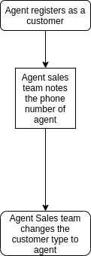
Link Agents to a staff
Creating customer of agent type:

Slide 8
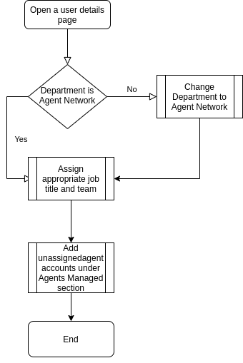
Link Agents to User - UX

Slide 9
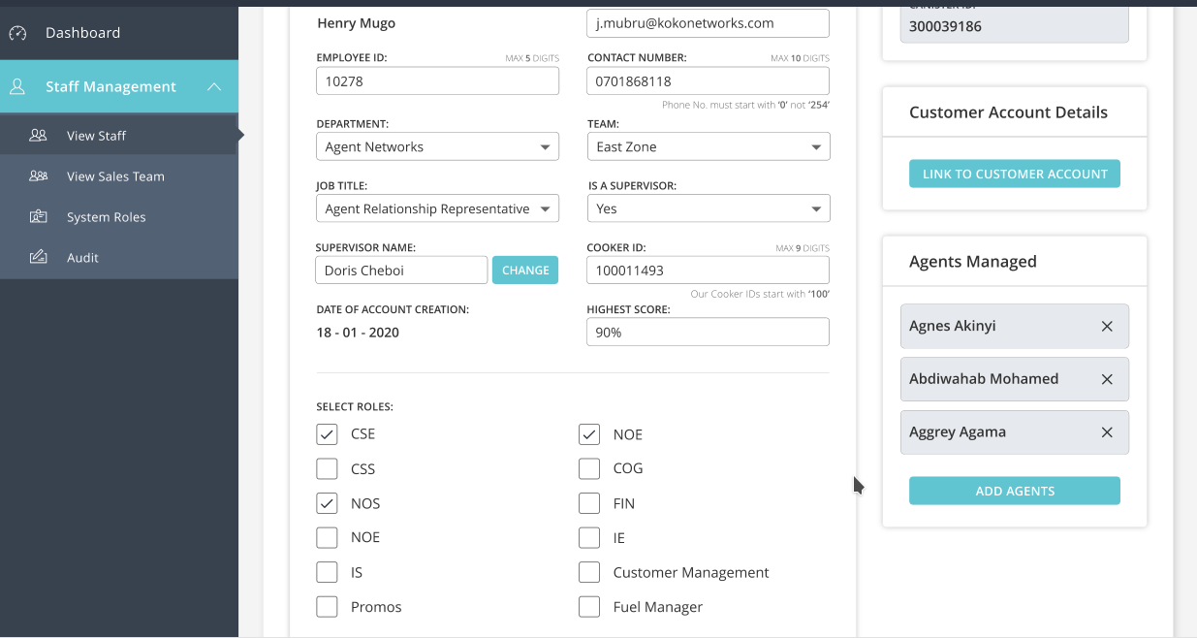
Linking Agents to User

Slide 10
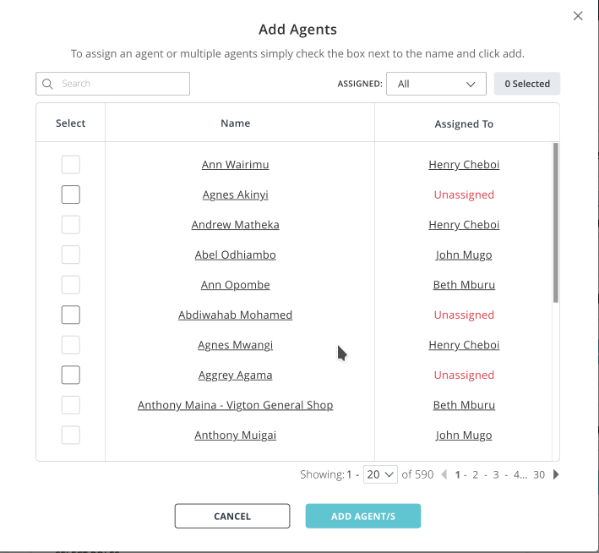
Linking Agents to User

Slide 11
Thank you

